Slide 1

Chapter 6 The Link Layer
and LANs
A note on the use of these PowerPoint slides:
We’re making these slides freely available to all (faculty, students, readers). They’re in PowerPoint form so you see the animations; and can add, modify, and delete slides (including this one) and slide content to suit your needs. They obviously represent a lot of work on our part. In return for use, we only ask the following:
If you use these slides (e.g., in a class) that you mention their source (after all, we’d like people to use our book!)
If you post any slides on a www site, that you note that they are adapted from (or perhaps identical to) our slides, and note our copyright of this material.
For a revision history, see the slide note for this page.
Thanks and enjoy! JFK/KWR
All material copyright 1996-2020
J.F Kurose and K.W. Ross, All Rights Reserved
Computer Networking: A Top-Down Approach 8th edition Jim Kurose, Keith Ross Pearson, 2020
Notes:
Version History
8.0 (May 2020)
All slides reformatted for 16:9 aspect ratio
All slides updated to 8th edition material
Use of Calibri font, rather that Gill Sans MT
Add LOTS more animation throughout
lighter header font
Updated datacenter slides, day-in-the-life

Slide 2

Link layer and LANs: our goals
understand principles behind link layer services:
error detection, correction
sharing a broadcast channel: multiple access
link layer addressing
local area networks: Ethernet, VLANs
datacenter networks
instantiation, implementation of various link layer technologies

Slide 3
Link layer, LANs: roadmap
introduction
error detection, correction
multiple access protocols
LANs
addressing, ARP
Ethernet
switches
VLANs
link virtualization: MPLS
data center networking
a day in the life of a web request

Slide 4








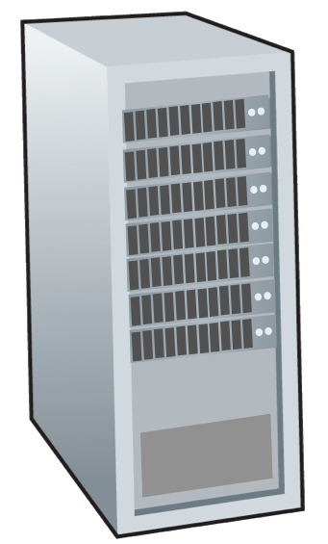







Link layer: introduction
terminology:
hosts and routers: nodes
communication channels that connect adjacent nodes along communication path: links
wired
wireless
LANs
layer-2 packet: frame, encapsulates datagram
mobile network
national or global ISP
datacenter
network
link layer has responsibility of
transferring datagram from one node
to physically adjacent node over a link
enterprise
network

Slide 5
Link layer: context
datagram transferred by different link protocols over different links:
e.g., WiFi on first link, Ethernet on next link
each link protocol provides different services
e.g., may or may not provide reliable data transfer over link

Slide 6


Link layer: services
framing, link access:
encapsulate datagram into frame, adding header, trailer
channel access if shared medium
“MAC” addresses in frame headers identify source, destination (different from IP address!)
reliable delivery between adjacent nodes
we already know how to do this!
seldom used on low bit-error links
wireless links: high error rates
Q: why both link-level and end-end reliability?
…
…

Slide 7
Link layer: services (more)
flow control:
pacing between adjacent sending and receiving nodes
error detection:
errors caused by signal attenuation, noise.
receiver detects errors, signals retransmission, or drops frame
error correction:
receiver identifies and corrects bit error(s) without retransmission
half-duplex and full-duplex:
with half duplex, nodes at both ends of link can transmit, but not at same time
…
…

Slide 8
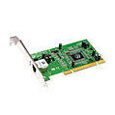
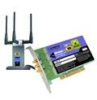

Where is the link layer implemented?
in each-and-every host
link layer implemented in network interface card (NIC) or on a chip
Ethernet, WiFi card or chip
implements link, physical layer
attaches into host’s system buses
combination of hardware, software, firmware
application
transport
network
link
cpu
memory
host bus
(e.g., PCI)
controller
link
physical
physical
network interface

Slide 9
Interfaces communicating
application
transport
network
link
application
transport
network
link
cpu
memory
memory
CPU
datagram
link_{h}
datagram
controller
controller
datagram
link_{h}
link
physical
link
physical
physical
physical
sending side:
encapsulates datagram in frame
adds error checking bits, reliable data transfer, flow control, etc.
receiving side:
looks for errors, reliable data transfer, flow control, etc.
extracts datagram, passes to upper layer at receiving side

Slide 10
Link layer, LANs: roadmap
introduction
error detection, correction
multiple access protocols
LANs
addressing, ARP
Ethernet
switches
VLANs
link virtualization: MPLS
data center networking
a day in the life of a web request

Slide 11



Multiple access links, protocols
two types of “links”:
point-to-point
point-to-point link between Ethernet switch, host
PPP for dial-up access
broadcast (shared wire or medium)
old-fashioned Ethernet
upstream HFC in cable-based access network
802.11 wireless LAN, 4G/4G. satellite
shared wire (e.g.,
cabled Ethernet)
shared radio: 4G/5G
shared radio: WiFi
shared radio: satellite
humans at a cocktail party
(shared air, acoustical)

Slide 12
Multiple access protocols
single shared broadcast channel
two or more simultaneous transmissions by nodes: interference
collision if node receives two or more signals at the same time
multiple access protocol
distributed algorithm that determines how nodes share channel, i.e., determine when node can transmit
communication about channel sharing must use channel itself!
no out-of-band channel for coordination

Slide 13
An ideal multiple access protocol
given: multiple access channel (MAC) of rate R bps
desiderata:
1. when one node wants to transmit, it can send at rate R.
2. when M nodes want to transmit, each can send at average rate R/M
3. fully decentralized:
no special node to coordinate transmissions
no synchronization of clocks, slots
4. simple

Slide 14
MAC protocols: taxonomy
three broad classes:
channel partitioning
divide channel into smaller “pieces” (time slots, frequency, code)
allocate piece to node for exclusive use
random access
channel not divided, allow collisions
“recover” from collisions
“taking turns”
nodes take turns, but nodes with more to send can take longer turns

Slide 15
Channel partitioning MAC protocols: TDMA
TDMA: time division multiple access
access to channel in “rounds”
each station gets fixed length slot (length = packet transmission time) in each round
unused slots go idle
example: 6-station LAN, 1,3,4 have packets to send, slots 2,5,6 idle
6-slot
frame
6-slot
frame
1
3
4
1
3
4

Slide 16
Channel partitioning MAC protocols: FDMA
FDMA: frequency division multiple access
channel spectrum divided into frequency bands
each station assigned fixed frequency band
unused transmission time in frequency bands go idle
example: 6-station LAN, 1,3,4 have packet to send, frequency bands 2,5,6 idle
time
frequency bands
FDM cable

Slide 17
Random access protocols
when node has packet to send
transmit at full channel data rate R.
no a priori coordination among nodes
two or more transmitting nodes: “collision”
random access MAC protocol specifies:
how to detect collisions
how to recover from collisions (e.g., via delayed retransmissions)
examples of random access MAC protocols:
ALOHA, slotted ALOHA
CSMA, CSMA/CD, CSMA/CA

Slide 18
CSMA (carrier sense multiple access)
simple CSMA: listen before transmit:
if channel sensed idle: transmit entire frame
if channel sensed busy: defer transmission
human analogy: don’t interrupt others!
CSMA/CD: CSMA with collision detection
collisions detected within short time
colliding transmissions aborted, reducing channel wastage
collision detection easy in wired, difficult with wireless
human analogy: the polite conversationalist

Slide 19
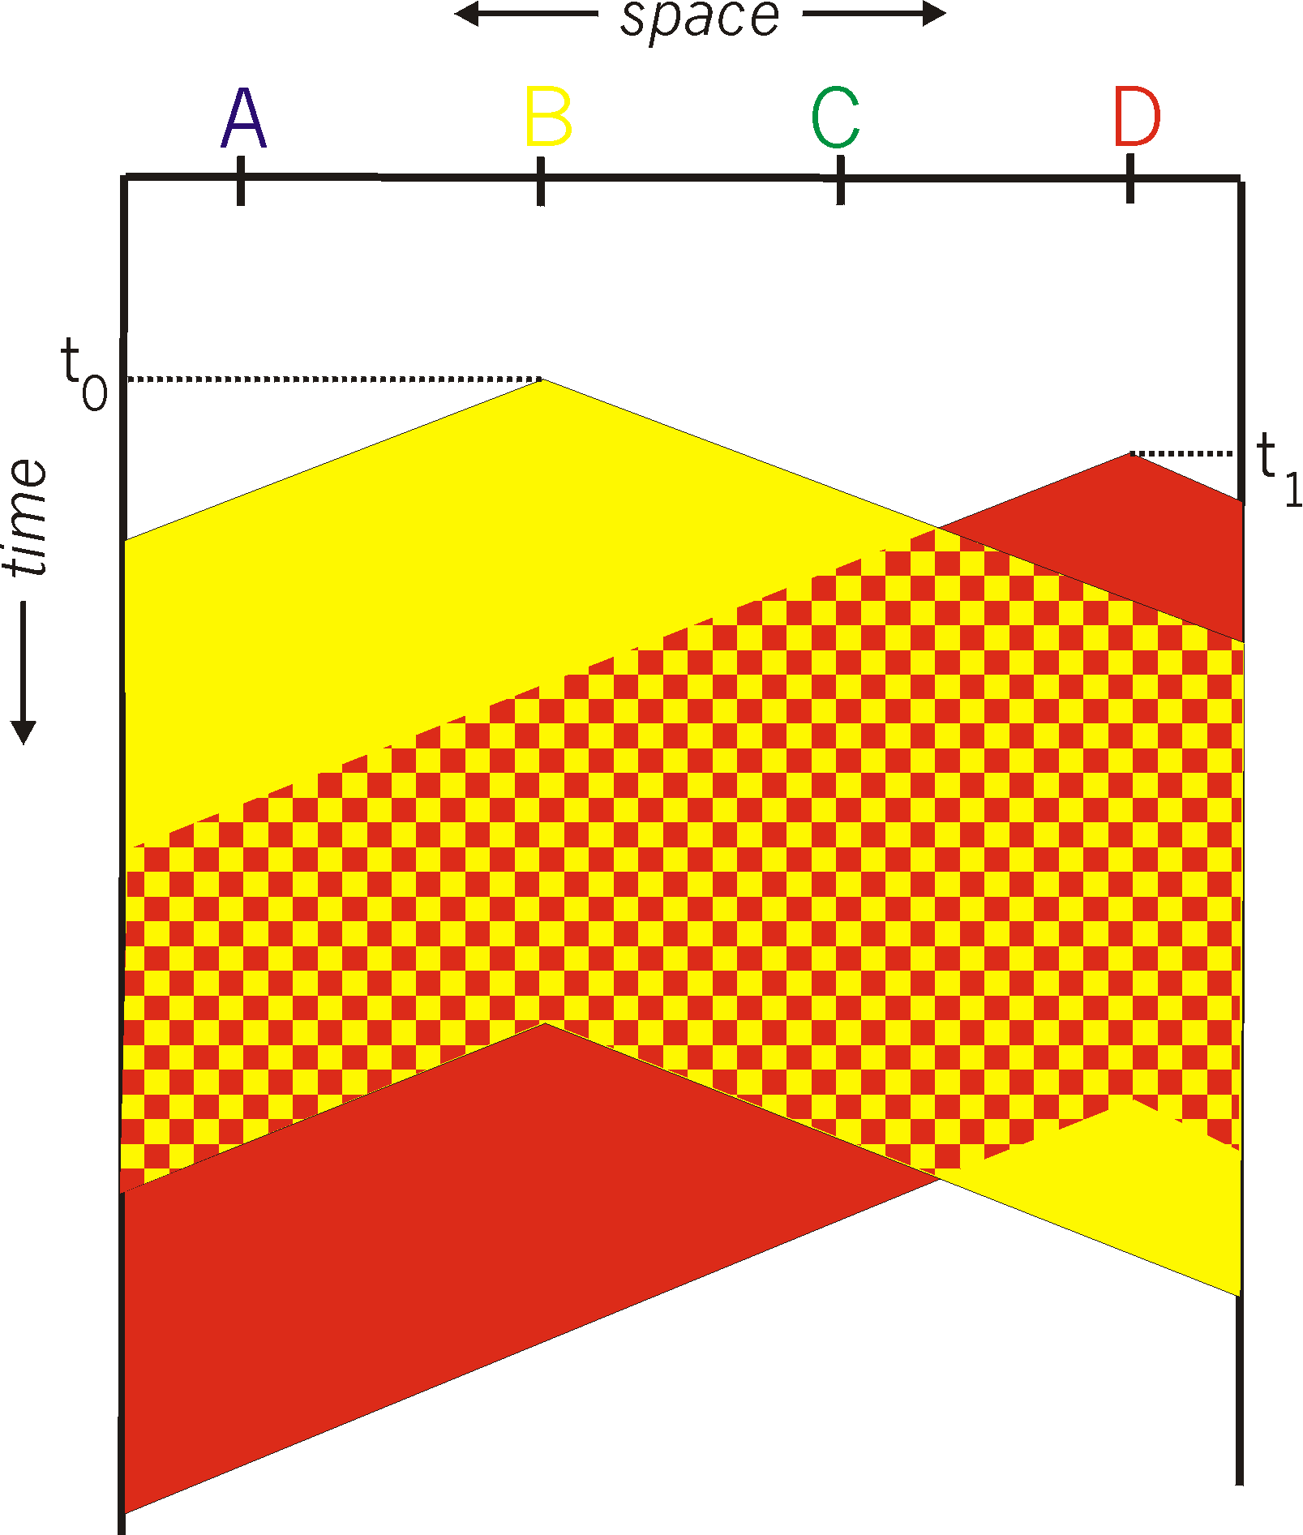
CSMA: collisions
spatial layout of nodes
collisions can still occur with carrier sensing:
propagation delay means two nodes may not hear each other’s just-started transmission
collision: entire packet transmission time wasted
distance & propagation delay play role in in determining collision probability

Slide 20
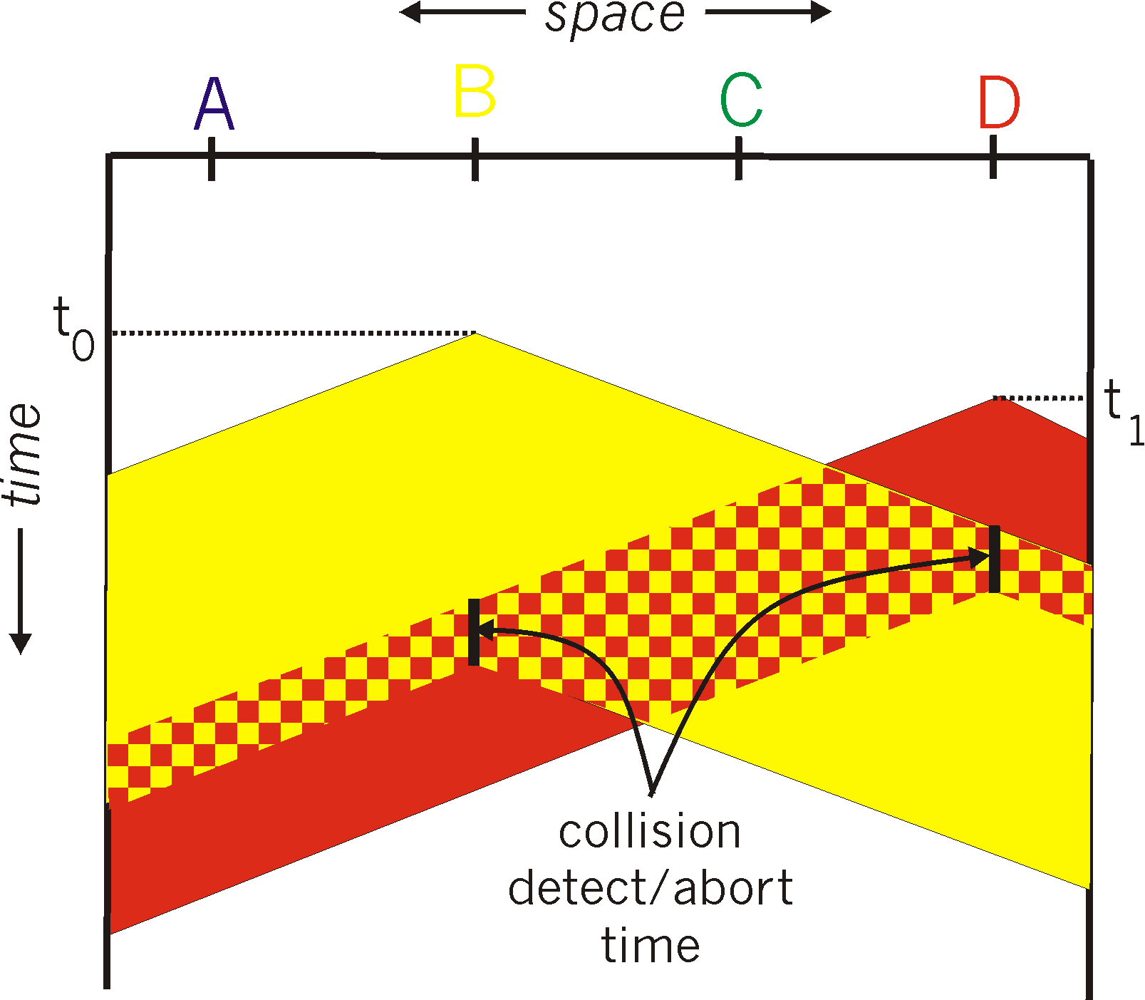
CSMA/CD:
spatial layout of nodes
CSMA/CS reduces the amount of time wasted in collisions
transmission aborted on collision detection

Slide 21
Ethernet CSMA/CD algorithm
NIC receives datagram from network layer, creates frame
If NIC senses channel:
if idle: start frame transmission.
if busy: wait until channel idle, then transmit
If NIC transmits entire frame without collision, NIC is done with frame !
If NIC detects another transmission while sending: abort, send jam signal
After aborting, NIC enters binary (exponential) backoff:
after mth collision, NIC chooses K at random from {0,1,2, …, 2^{m}-1}. NIC waits K·512 bit times, returns to Step 2
more collisions: longer backoff interval

Slide 22
Summary of MAC protocols
channel partitioning, by time, frequency or code
Time Division, Frequency Division
random access (dynamic),
ALOHA, S-ALOHA, CSMA, CSMA/CD
carrier sensing: easy in some technologies (wire), hard in others (wireless)
CSMA/CD used in Ethernet
CSMA/CA used in 802.11
taking turns
polling from central site, token passing
Bluetooth, FDDI, token ring

Slide 23
Link layer, LANs: roadmap
introduction
error detection, correction
multiple access protocols
LANs
addressing, ARP
Ethernet
switches
VLANs
link virtualization: MPLS
data center networking
a day in the life of a web request

Slide 24
MAC addresses
32-bit IP address:
network-layer address for interface
used for layer 3 (network layer) forwarding
e.g.: 128.119.40.136
MAC (or LAN or physical or Ethernet) address:
function: used “locally” to get frame from one interface to another physically-connected interface (same subnet, in IP-addressing sense)
48-bit MAC address (for most LANs) burned in NIC ROM, also sometimes software settable
e.g.: 1A-2F-BB-76-09-AD
hexadecimal (base 16) notation
(each “numeral” represents 4 bits)

Slide 25
MAC addresses
each interface on LAN
has unique 48-bit MAC address
has a locally unique 32-bit IP address (as we’ve seen)
137.196.7.78
1A-2F-BB-76-09-AD
LAN
(wired or wireless)
137.196.7/24
71-65-F7-2B-08-53
58-23-D7-FA-20-B0
137.196.7.23
137.196.7.14
0C-C4-11-6F-E3-98
137.196.7.88

Slide 26
MAC addresses
MAC address allocation administered by IEEE
manufacturer buys portion of MAC address space (to assure uniqueness)
analogy:
MAC address: like Social Security Number
IP address: like postal address
MAC flat address: portability
can move interface from one LAN to another
recall IP address not portable: depends on IP subnet to which node is attached

Slide 27
ARP: address resolution protocol
Question: how to determine interface’s MAC address, knowing its IP address?
ARP table: each IP node (host, router) on LAN has table
ARP
137.196.7.78
IP/MAC address mappings for some LAN nodes:
< IP address; MAC address; TTL>
TTL (Time To Live): time after which address mapping will be forgotten (typically 20 min)
1A-2F-BB-76-09-AD
ARP
ARP
LAN
71-65-F7-2B-08-53
58-23-D7-FA-20-B0
137.196.7.23
137.196.7.14
ARP
0C-C4-11-6F-E3-98
137.196.7.88

Slide 28
ARP protocol in action
example: A wants to send datagram to B
B’s MAC address not in A’s ARP table, so A uses ARP to find B’s MAC address
A broadcasts ARP query, containing B's IP addr
destination MAC address = FF-FF-FF-FF-FF-FF
all nodes on LAN receive ARP query
1
Ethernet frame (sent to FF-FF-FF-FF-FF-FF)
C
Source MAC: 71-65-F7-2B-08-53
Source IP: 137.196.7.23
Target IP address: 137.196.7.14
…
ARP table in A
IP addr
MAC addr
TTL
TTL
A
B
1
71-65-F7-2B-08-53
58-23-D7-FA-20-B0
137.196.7.23
137.196.7.14
D

Slide 29
ARP protocol in action
example: A wants to send datagram to B
B’s MAC address not in A’s ARP table, so A uses ARP to find B’s MAC address
ARP message into Ethernet frame (sent to 71-65-F7-2B-08-53)
C
Target IP address: 137.196.7.14
Target MAC address:
58-23-D7-FA-20-B0
…
ARP table in A
IP addr
MAC addr
TTL
TTL
A
B
2
71-65-F7-2B-08-53
58-23-D7-FA-20-B0
137.196.7.23
137.196.7.14
2
B replies to A with ARP response, giving its MAC address
D

Slide 30
ARP protocol in action
example: A wants to send datagram to B
B’s MAC address not in A’s ARP table, so A uses ARP to find B’s MAC address
C
ARP table in A
IP addr
MAC addr
TTL
TTL
A
B
137.196.
7.14
58-23-D7-FA-20-B0
500
71-65-F7-2B-08-53
58-23-D7-FA-20-B0
137.196.7.23
137.196.7.14
3
A receives B’s reply, adds B entry into its local ARP table
D

Slide 31

Routing to another subnet: addressing
walkthrough: sending a datagram from A to B via R
focus on addressing – at IP (datagram) and MAC layer (frame) levels
assume that:
A knows B’s IP address
A knows IP address of first hop router, R (how?)
A knows R’s MAC address (how?)
A
R
B
111.111.111.111
74-29-9C-E8-FF-55
222.222.222.222
49-BD-D2-C7-56-2A
222.222.222.220
1A-23-F9-CD-06-9B
111.111.111.112
111.111.111.110
CC-49-DE-D0-AB-7D
E6-E9-00-17-BB-4B
222.222.222.221
88-B2-2F-54-1A-0F

Slide 32
Routing to another subnet: addressing
A creates IP datagram with IP source A, destination B
A creates link-layer frame containing A-to-B IP datagram
R's MAC address is frame’s destination
MAC src: 74-29-9C-E8-FF-55
MAC dest: E6-E9-00-17-BB-4B
IP
Eth
Phy
IP src: 111.111.111.111
IP dest: 222.222.222.222
A
R
B
111.111.111.111
74-29-9C-E8-FF-55
222.222.222.222
49-BD-D2-C7-56-2A
222.222.222.220
1A-23-F9-CD-06-9B
111.111.111.112
111.111.111.110
CC-49-DE-D0-AB-7D
E6-E9-00-17-BB-4B
222.222.222.221
88-B2-2F-54-1A-0F

Slide 33
Routing to another subnet: addressing
frame sent from A to R
frame received at R, datagram removed, passed up to IP
MAC src: 74-29-9C-E8-FF-55
MAC dest: E6-E9-00-17-BB-4B
IP src: 111.111.111.111
IP dest: 222.222.222.222
IP
Eth
Phy
IP src: 111.111.111.111
IP dest: 222.222.222.222
IP
Eth
Phy
A
R
B
111.111.111.111
74-29-9C-E8-FF-55
222.222.222.222
49-BD-D2-C7-56-2A
222.222.222.220
1A-23-F9-CD-06-9B
111.111.111.112
111.111.111.110
CC-49-DE-D0-AB-7D
E6-E9-00-17-BB-4B
222.222.222.221
88-B2-2F-54-1A-0F

Slide 34
Routing to another subnet: addressing
R determines outgoing interface, passes datagram with IP source A, destination B to link layer
R creates link-layer frame containing A-to-B IP datagram. Frame destination address: B's MAC address
MAC src: 1A-23-F9-CD-06-9B
MAC dest: 49-BD-D2-C7-56-2A
IP
Eth
Phy
IP src: 111.111.111.111
IP dest: 222.222.222.222
A
R
B
111.111.111.111
74-29-9C-E8-FF-55
222.222.222.222
49-BD-D2-C7-56-2A
222.222.222.220
1A-23-F9-CD-06-9B
111.111.111.112
111.111.111.110
CC-49-DE-D0-AB-7D
E6-E9-00-17-BB-4B
222.222.222.221
88-B2-2F-54-1A-0F

Slide 35
Routing to another subnet: addressing
R determines outgoing interface, passes datagram with IP source A, destination B to link layer
R creates link-layer frame containing A-to-B IP datagram. Frame destination address: B's MAC address
MAC src: 1A-23-F9-CD-06-9B
MAC dest: 49-BD-D2-C7-56-2A
transmits link-layer frame
IP
Eth
Phy
IP
Eth
Phy
IP src: 111.111.111.111
IP dest: 222.222.222.222
A
R
B
111.111.111.111
74-29-9C-E8-FF-55
222.222.222.222
49-BD-D2-C7-56-2A
222.222.222.220
1A-23-F9-CD-06-9B
111.111.111.112
111.111.111.110
CC-49-DE-D0-AB-7D
E6-E9-00-17-BB-4B
222.222.222.221
88-B2-2F-54-1A-0F

Slide 36
Routing to another subnet: addressing
B receives frame, extracts IP datagram destination B
B passes datagram up protocol stack to IP
IP src: 111.111.111.111
IP dest: 222.222.222.222
IP
Eth
Phy
IP
Eth
Phy
A
R
B
111.111.111.111
74-29-9C-E8-FF-55
222.222.222.222
49-BD-D2-C7-56-2A
222.222.222.220
1A-23-F9-CD-06-9B
111.111.111.112
111.111.111.110
CC-49-DE-D0-AB-7D
E6-E9-00-17-BB-4B
222.222.222.221
88-B2-2F-54-1A-0F

Slide 37
Link layer, LANs: roadmap
introduction
error detection, correction
multiple access protocols
LANs
addressing, ARP
Ethernet
switches
VLANs
link virtualization: MPLS
data center networking
a day in the life of a web request

Slide 38
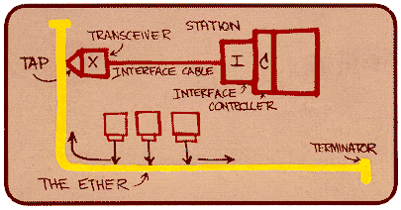
Ethernet
“dominant” wired LAN technology:
first widely used LAN technology
simpler, cheap
kept up with speed race: 10 Mbps – 400 Gbps
single chip, multiple speeds (e.g., Broadcom BCM5761)
Metcalfe’s Ethernet sketch
https://www.uspto.gov/learning-and-resources/journeys-innovation/audio-stories/defying-doubters

Slide 39
Ethernet: physical topology
bus: popular through mid 90s
all nodes in same collision domain (can collide with each other)
switched: prevails today
active link-layer 2 switch in center
each “spoke” runs a (separate) Ethernet protocol (nodes do not collide with each other)
bus: coaxial cable
switched

Slide 40
Ethernet frame structure
sending interface encapsulates IP datagram (or other network layer protocol packet) in Ethernet frame
type
preamble
dest.
address
source
address
data (payload)
CRC
preamble:
used to synchronize receiver, sender clock rates
7 bytes of 10101010 followed by one byte of 10101011

Slide 41
Ethernet frame structure (more)
type
preamble
dest.
address
source
address
data (payload)
CRC
addresses: 6 byte source, destination MAC addresses
if adapter receives frame with matching destination address, or with broadcast address (e.g., ARP packet), it passes data in frame to network layer protocol
otherwise, adapter discards frame
type: indicates higher layer protocol
mostly IP but others possible, e.g., Novell IPX, AppleTalk
used to demultiplex up at receiver
CRC: cyclic redundancy check at receiver
error detected: frame is dropped

Slide 42
Ethernet: unreliable, connectionless
connectionless: no handshaking between sending and receiving NICs
unreliable: receiving NIC doesn’t send ACKs or NAKs to sending NIC
data in dropped frames recovered only if initial sender uses higher layer rdt (e.g., TCP), otherwise dropped data lost
Ethernet’s MAC protocol: unslotted CSMA/CD with binary backoff

Slide 43
802.3 Ethernet standards: link & physical layers
many different Ethernet standards
common MAC protocol and frame format
different speeds: 2 Mbps, 10 Mbps, 100 Mbps, 1Gbps, 10 Gbps, 40 Gbps
different physical layer media: fiber, cable
application
transport
network
link
physical
MAC protocol
and frame format
100BASE-TX
100BASE-T2
100BASE-FX
100BASE-T4
100BASE-SX
100BASE-BX
copper (twister pair) physical layer
fiber physical layer

Slide 44
Link layer, LANs: roadmap
introduction
error detection, correction
multiple access protocols
LANs
addressing, ARP
Ethernet
switches
VLANs
link virtualization: MPLS
data center networking
a day in the life of a web request

Slide 45
Ethernet switch
Switch is a link-layer device: takes an active role
store, forward Ethernet frames
examine incoming frame’s MAC address, selectively forward frame to one-or-more outgoing links when frame is to be forwarded on segment, uses CSMA/CD to access segment
transparent: hosts unaware of presence of switches
plug-and-play, self-learning
switches do not need to be configured

Slide 46
Switch: multiple simultaneous transmissions
hosts have dedicated, direct connection to switch
switches buffer packets
Ethernet protocol used on each incoming link, so:
no collisions; full duplex
each link is its own collision domain
A
C’
B
1
2
6
3
5
4
B’
C
A’
switching: A-to-A’ and B-to-B’ can transmit simultaneously, without collisions
switch with six interfaces (1,2,3,4,5,6)

Slide 47

Switch: multiple simultaneous transmissions
hosts have dedicated, direct connection to switch
switches buffer packets
Ethernet protocol used on each incoming link, so:
no collisions; full duplex
each link is its own collision domain
A
C’
B
1
2
6
3
5
4
B’
C
A’
switching: A-to-A’ and B-to-B’ can transmit simultaneously, without collisions
but A-to-A’ and C to A’ can not happen simultaneously
switch with six interfaces (1,2,3,4,5,6)

Slide 48
Switch forwarding table
Q: how does switch know A’ reachable via interface 4, B’ reachable via interface 5?
A
C’
B
A: each switch has a switch table, each entry:
(MAC address of host, interface to reach host, time stamp)
looks like a routing table!
1
2
6
3
5
4
B’
C
A’
Q: how are entries created, maintained in switch table?
something like a routing protocol?

Slide 49
Switch: self-learning
Source: A
switch learns which hosts can be reached through which interfaces
Dest: A’
A A’
A
C’
B
when frame received, switch “learns” location of sender: incoming LAN segment
1
2
6
3
5
4
records sender/location pair in switch table
B’
C
A’
Switch table
(initially empty)
MAC addr interface TTL
A
1
60

Slide 50
Switch: frame filtering/forwarding
when frame received at switch:
1. record incoming link, MAC address of sending host
2. index switch table using MAC destination address
3. if entry found for destination then {
if destination on segment from which frame arrived then drop frame
else forward frame on interface indicated by entry
}
else flood /* forward on all interfaces except arriving interface */

Slide 51
Self-learning, forwarding: example
Source: A
Dest: A’
frame destination, A’, location unknown:
A A’
flood
A
C’
B
destination A location known:
selectively send
on just one link
1
2
6
A A’
A A’
A A’
A A’
A A’
3
5
4
B’
C
A’ A
A’
MAC addr interface TTL
A
1
60
switch table
(initially empty)
A’
4
60

Slide 52


Interconnecting switches
self-learning switches can be connected together:
S₄
S₁
S₃
A
S₂
F
I
B
C
D
E
G
H
Q: sending from A to G - how does S₁ know to forward frame destined to G via S₄ and S₃?
A: self learning! (works exactly the same as in single-switch case!)

Slide 53
Self-learning multi-switch example
Suppose C sends frame to I, I responds to C
S₄
S₁
S₃
A
S₂
F
I
B
C
D
E
G
H
Q: show switch tables and packet forwarding in S₁, S₂, S₃, S₄

Slide 54
Small institutional network
mail server
to external
network
router
web server
IP subnet

Slide 55
Switches vs. routers
application
transport
network
link
physical
both are store-and-forward:
routers: network-layer devices (examine network-layer headers)
switches: link-layer devices (examine link-layer headers)
datagram
frame
link
physical
frame
switch
network
link
physical
datagram
both have forwarding tables:
routers: compute tables using routing algorithms, IP addresses
switches: learn forwarding table using flooding, learning, MAC addresses
frame
application
transport
network
link
physical
6-55

